Slide 1





Real-Time Traffic Monitoring and Analysis

Slide 2



OUR TEAM
Ahmed Mohamed Abdelsalam Sherif
Khaled Taha Taha Beheiry
Mohamed Haitham Ezzat Yamani
Maged Mohamed Mohamed Mousa

Slide 3


Why Real-Time Traffic Monitoring and Analysis
????

Slide 4
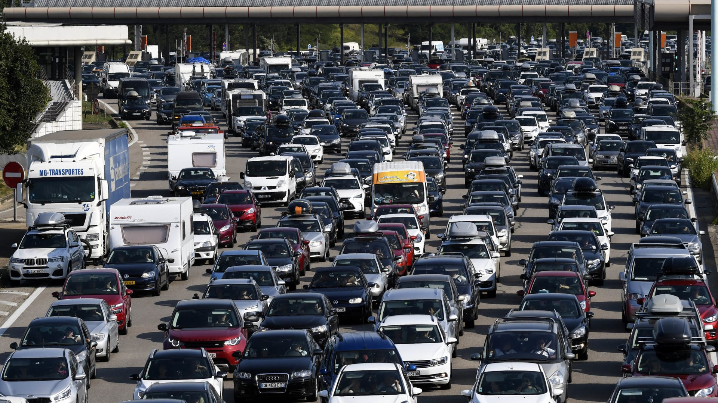



Slide 5
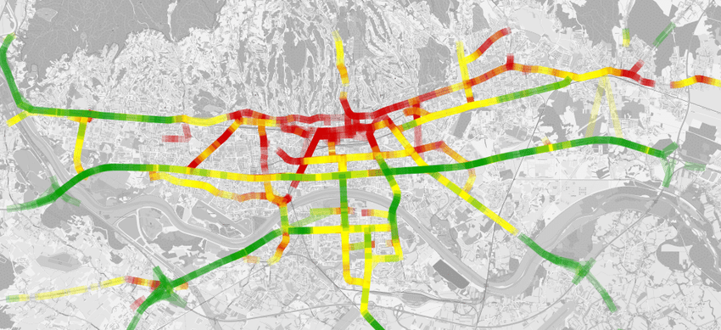

Slide 6
Database and Data Collection
The database schema includes three key tables:
Traffic_Sensors
Traffic_Logs
Incidents

Slide 7
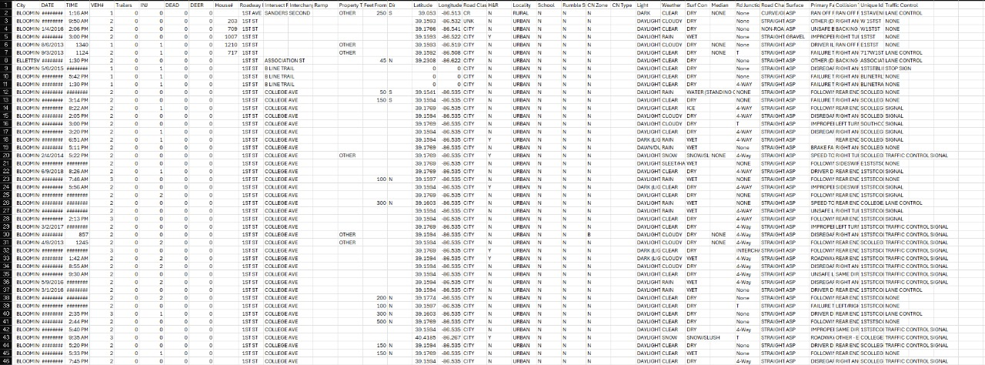
Data Collection

Slide 8
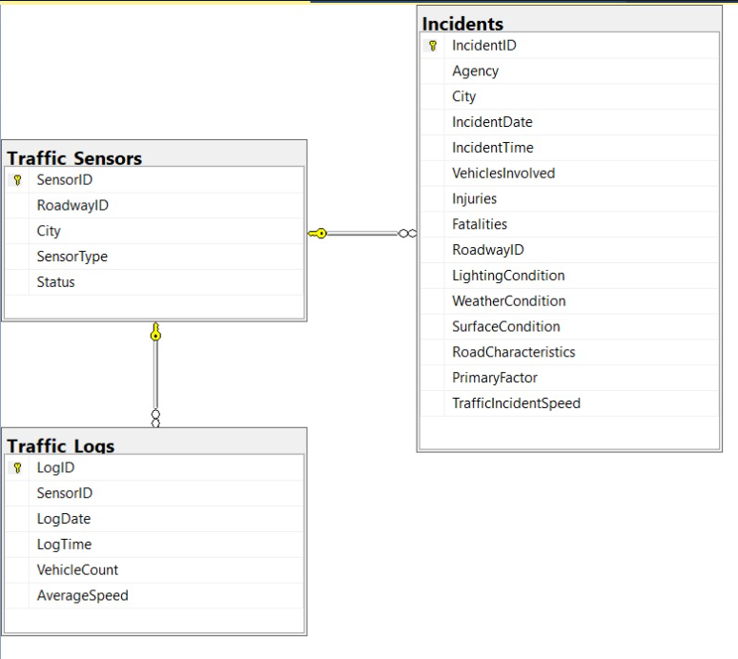

Slide 10
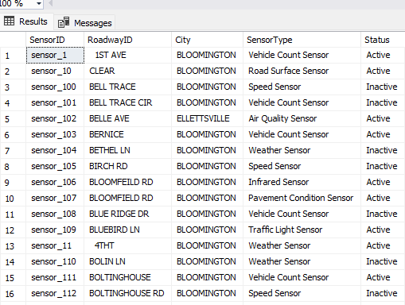

Slide 11
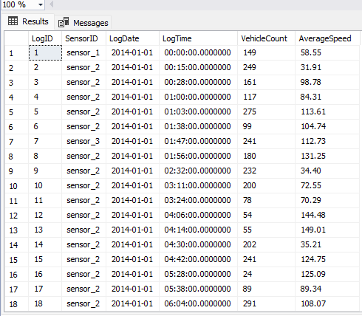

Slide 12
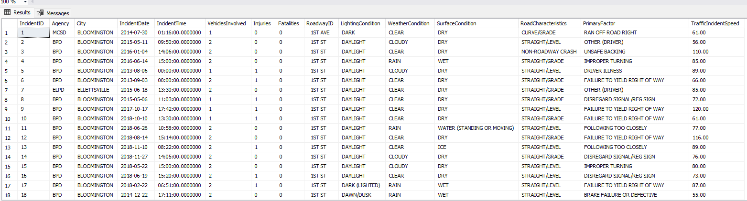

Slide 13
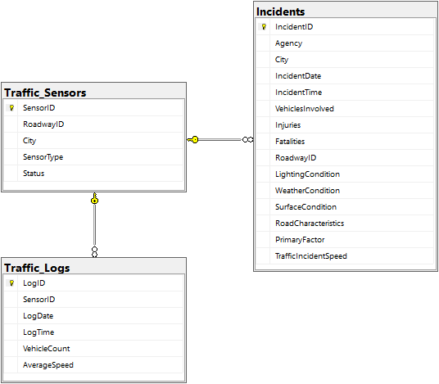
Data Warehouse Schema Overview
Fact Table:
Traffic_Logs table acts as the fact table, containing metrics such as the number of vehicles and average speed. These represent the key measurable data points collected from sensors over time.
Dimension Tables:
Traffic_Sensors: Serves as a dimension table, providing context for the sensor locations, types, and statuses.
Incidents: Another dimension table, offering detailed descriptive information about traffic incidents, such as the number of vehicles involved, fatalities, and conditions at the time.

Slide 14
Schema Design and Relationships
Fact Table (Traffic_Logs): Captures quantitative data (vehicle count, speed) that can be aggregated for different analyses, such as average traffic flow or peak congestion times.
Dimension Tables:
Traffic_Sensors: Describes the context of where the data is collected, including sensor type, city, and status.
Incidents: Describes additional context, enabling us to correlate traffic conditions with real-world incidents (injuries, weather, etc.).
Relationships:
One-to-many relationship between sensors and logs allows tracking traffic data over time.
The link between incidents and sensors enables analysis of traffic behavior surrounding incidents.

Slide 15
Benefits of the Warehouse Schema
Centralized Data Repository:
Combines real-time sensor data, traffic logs, and incident reports into a single source of truth.
Facilitates data consistency and reliability for all traffic-related analysis.
Efficient Querying and Reporting:
Fact-Dimension Modeling enables optimized query performance, allowing for faster retrieval of insights across large datasets.
Improved Decision-Making:
Empowers traffic authorities with actionable insights into traffic flow, congestion, and incidents.
Enables proactive traffic management through timely detection of traffic issues and predictive insights into potential risks.

Slide 16

ETL Process Overview
ETL Objective:
The ETL process extracts Data from the database in SQL Server and loads it into the data warehouse for analysis and reporting.

Slide 17
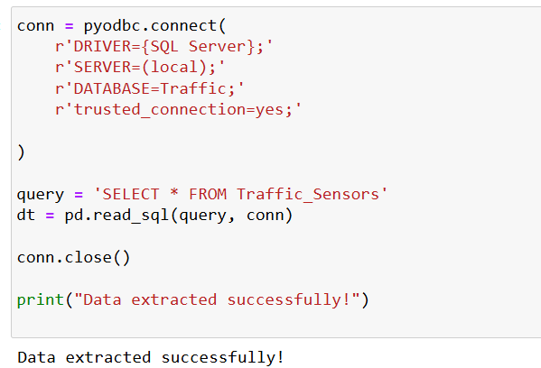
Extraction Phase
Tool Used: Python with PyODBC library for SQL Server connectivity.
Source: The traffic sensor data is extracted from the Traffic operational database.
Query:
SQL query SELECT * FROM Traffic_Sensors is used to retrieve sensor information such as SensorID, RoadwayID, City, SensorType, and Status.
Extracted data is loaded into a Pandas DataFrame for further processing.

Slide 18
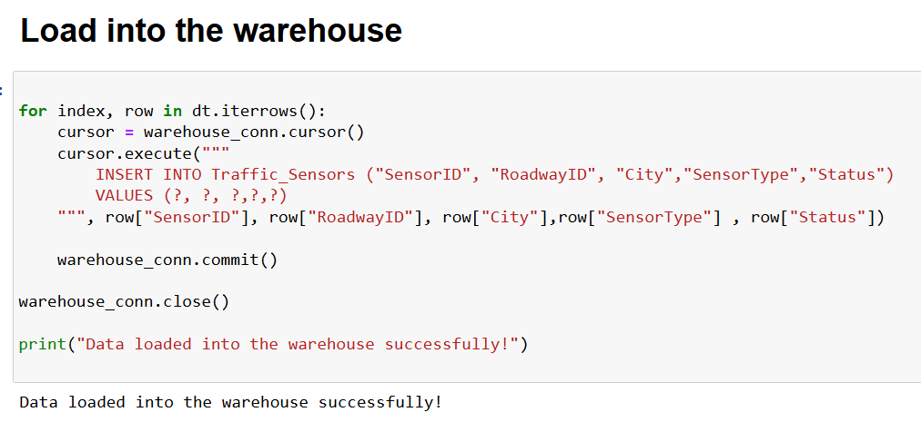
Loading Phase
Destination: The extracted data is then loaded into the Traffic Sensors table in the data warehouse.
Process: For each row in the DataFrame:
An INSERT query is executed using PyODBC to add sensor data to the warehouse.
Commit and Connection Closure: After each record is inserted, the changes are committed to the warehouse, and the connection is closed.

Slide 19

Key Benefits of the ETL Process
Automation and Efficiency:
The process is fully automated, allowing for quick and efficient data transfer from the source to the warehouse without manual intervention.
Consistency in Data:
The direct transfer ensures that the sensor data remains consistent between the operational system and the data warehouse, supporting accurate analysis and reporting.
Scalability:
The ETL process can be scaled to handle larger datasets or modified to accommodate additional data sources in the future.
Real-time Updates:
This approach supports near real-time data loading into the warehouse, ensuring the traffic monitoring system has up-to-date information.

Slide 20

Data Analysis

Slide 21
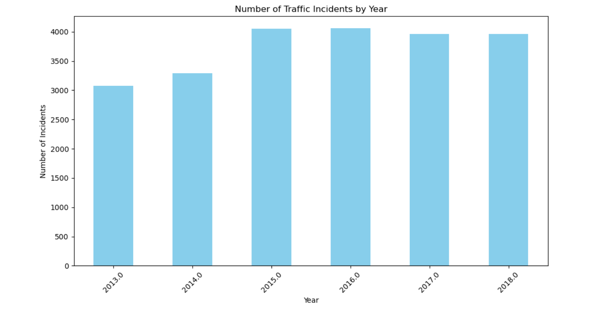
Plot 1: Number of Traffic Incidents by Year
Interpretation:
The bar chart shows the trend in traffic incidents over the years. An increase in incidents suggests growing traffic volumes or safety concerns, whereas a decrease indicates possible road safety improvements.
Actionable Insight:
If the number of incidents is rising, traffic authorities may need to improve road safety, increase traffic enforcement, or address areas with frequent accidents.

Slide 22
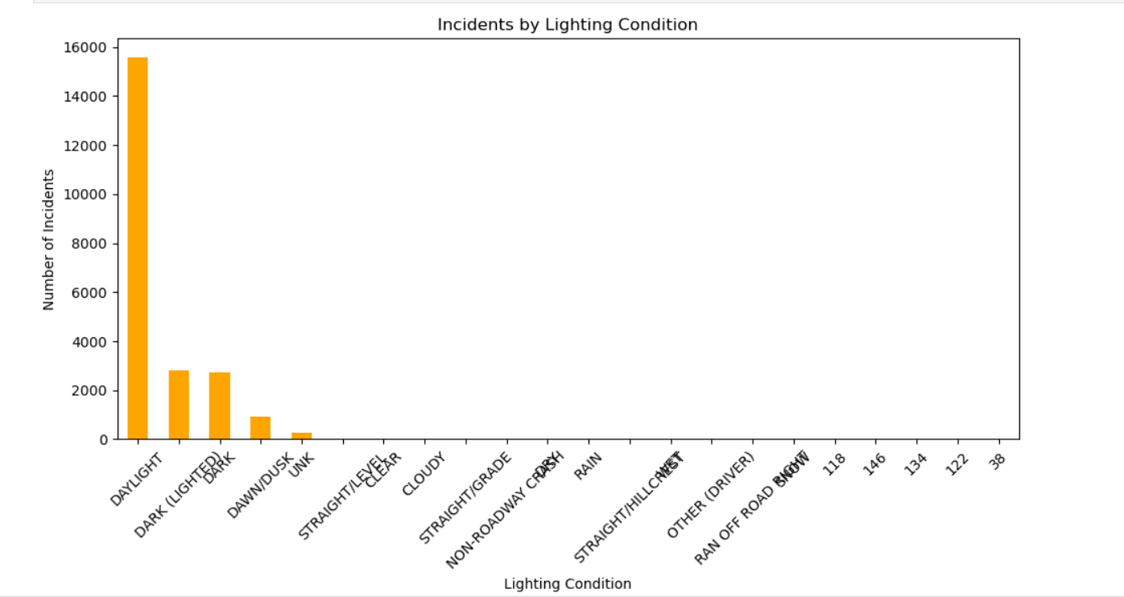

Plot 2: Incidents by Lighting Condition
Interpretation:
The number of incidents varies during different lighting conditions (e.g., daylight, night, dawn). More incidents during poor lighting suggest visibility issues at night.
Actionable Insight:
Improve street lighting in areas where incidents frequently occur at night.

Slide 23
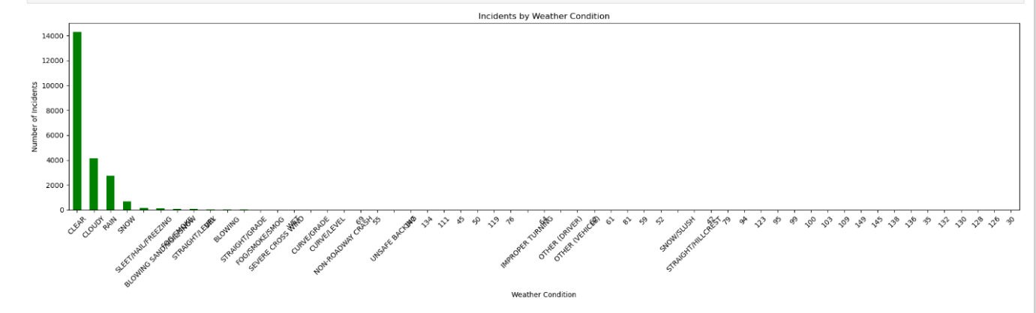
Plot 3: Incidents by Weather Condition
Interpretation:
The bar chart shows a rise in incidents during poor weather conditions (e.g., rain, fog). This indicates a need for road safety improvements in these conditions.
Actionable Insight:
Introduce driver awareness programs and enhance signage to warn drivers about dangerous driving conditions during adverse weather.

Slide 24
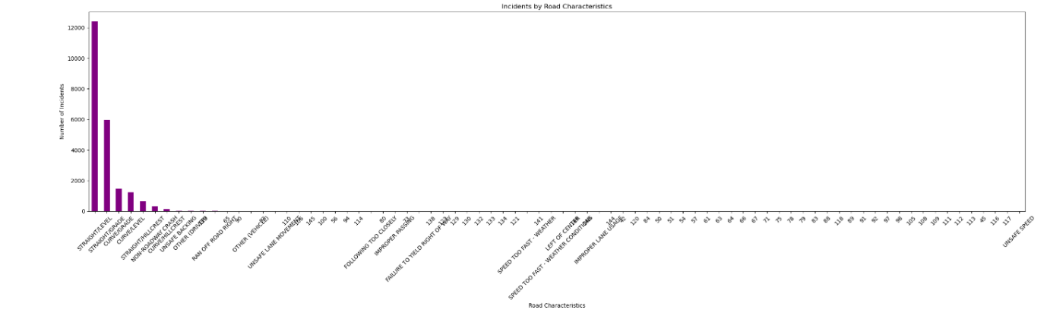
Plot 4: Incidents by Road Characteristics
Interpretation:
Incidents based on road characteristics (e.g., straight roads, curves, intersections) show that certain road types may have higher accident rates.
Actionable Insight:
Consider improving road design and signage in high-incident areas, such as marking curves more clearly or redesigning dangerous intersections.

Slide 25
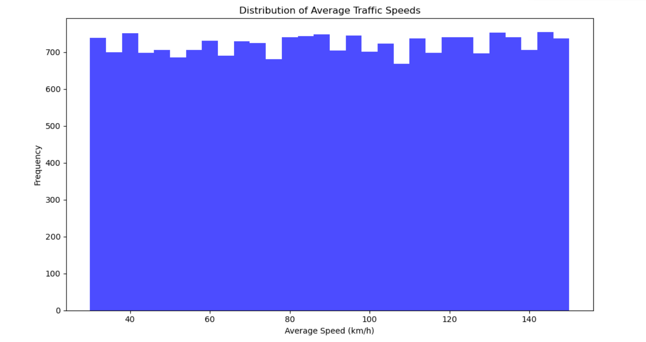
Plot 5: Distribution of Average Traffic Speeds
Interpretation:
The histogram shows the distribution of traffic speeds. Most vehicles travel within a particular speed range, indicating typical traffic flow. Deviations could signal congestion or speeding.
Actionable Insight:
Assess whether speed limits align with actual traffic speeds. If many vehicles exceed the limit, consider stricter enforcement.

Slide 26
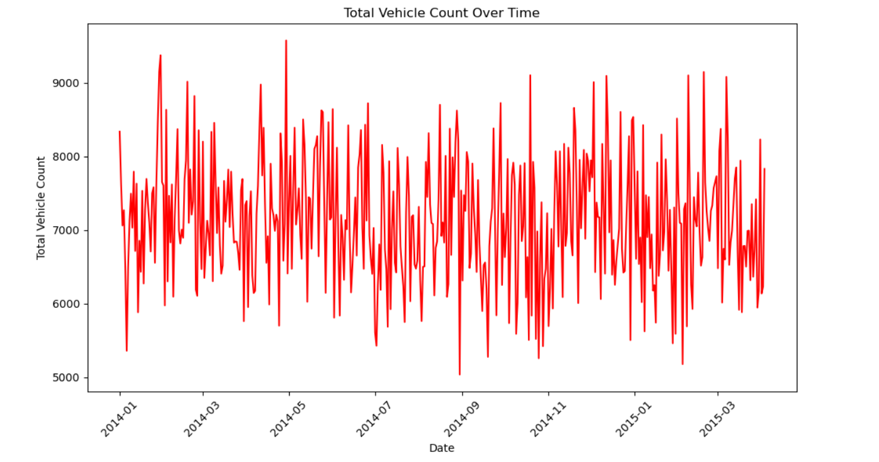
Plot 6: Total Vehicle Count Over Time
Interpretation:
This line chart illustrates the total vehicle count on roads over time. Peaks in traffic volume may correlate with holidays or events.
Actionable Insight:
Prepare for traffic peaks by adjusting signal timings and increasing traffic management during high-volume periods.

Slide 27
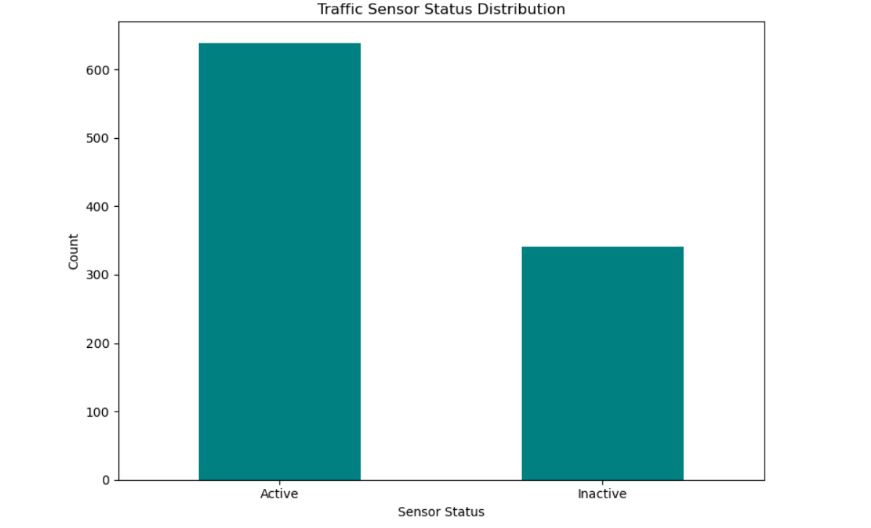
Plot 7: Traffic Sensor Status Distribution
Interpretation:
The bar chart shows the distribution of traffic sensor statuses (e.g., online, offline). Offline or malfunctioning sensors can lead to inaccurate data, affecting traffic analysis.
Actionable Insight:
Prioritize maintenance and repair of sensors to ensure accurate traffic monitoring.

Slide 28
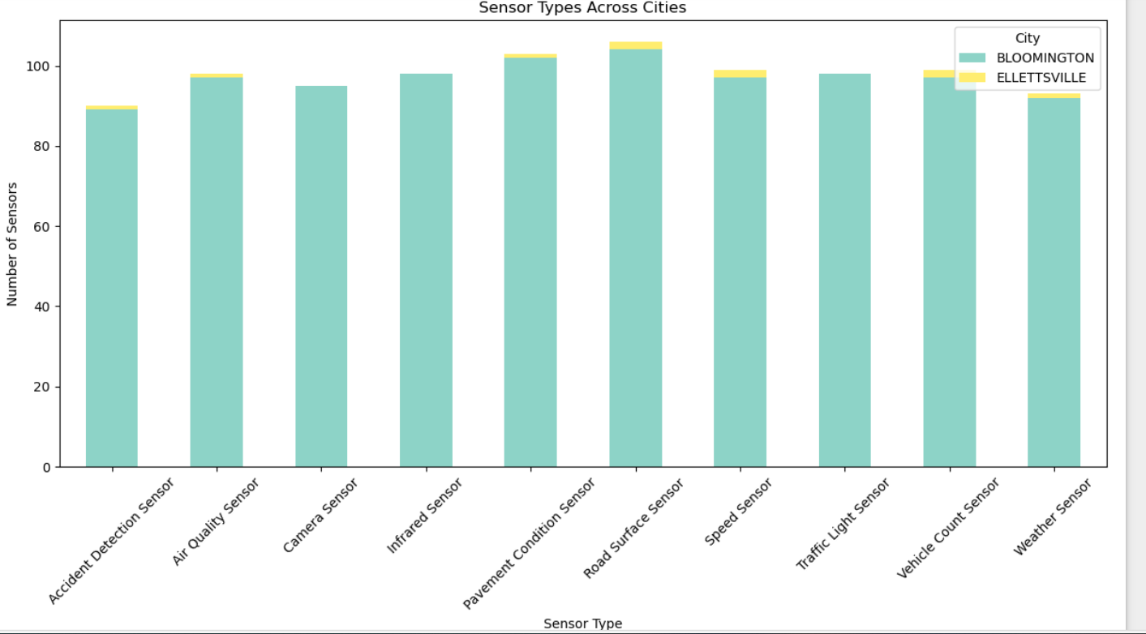
Plot 8: Sensor Types Across Cities
Interpretation:
This stacked bar chart visualizes sensor types (e.g., speed sensors, vehicle counters) across cities. Disparities in sensor distribution can lead to uneven traffic monitoring.
Actionable Insight:
Deploy additional sensors in cities with high traffic incidents to enhance data collection and improve traffic management.

Slide 29
Summary of Insights:
Traffic Trends: The number of incidents fluctuates over the years, highlighting long-term trends in road safety and areas for improvement.
Environmental Factors: Poor lighting, adverse weather conditions, and certain road characteristics contribute to more incidents. Safety measures targeting these areas can reduce risks.
Traffic Flow: Vehicle counts and speed distribution help identify traffic congestion points or speeding hotspots.
Sensor Monitoring: Regular sensor maintenance and even distribution across cities are vital for effective traffic monitoring.

Slide 30
Congestion predictive model

Slide 31

Traffic Congestion Prediction Overview
Project Objective: Predict traffic congestion based on real-time environmental and road conditions using machine learning.
Key Features Used:
Lighting Condition (Daylight, Night)
Weather Condition (Clear, Rainy)
Surface Condition (Dry, Wet)
Road Characteristics (Straight, Curve)
Traffic Speed (mph)

Slide 32
Data Preprocessing:
Categorical features are mapped to numerical weights.Missing values are handled by default values or removing rows.Congestion Score: Calculated based on the sum of weights for different conditions, with low speeds contributing more to congestion

Slide 33

Model Development & Predictions
Model Development : One-hot encoding for categorical features.Trained on traffic incident data using a classification model (e.g., Random Forest ).Split into training and test sets to evaluate performance.
Next Steps : I ntegrate with real-time data sources and deploy on Azure for live traffic monitoring

Slide 34
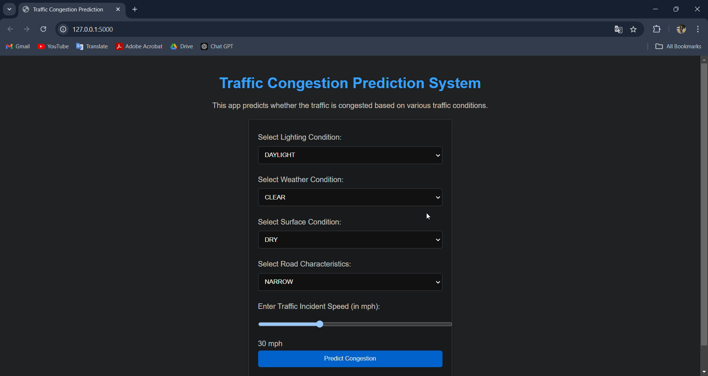

Slide 35
Conclusion: Real-Time Traffic Monitoring and Analysis
SQL Database Design & Data Management
Learned to design and manage traffic data using SQL databases.Developed skills in querying and summarizing traffic data, improving my database management proficiency.
2. Data Warehousing & Python Integration
Gained experience in setting up a data warehouse for handling large-scale traffic data.Improved knowledge of ETL processes and Python scripting for data extraction and preprocessing.

Slide 36
3. Traffic Analysis & Predictive Modeling
Strengthened my ability to analyze traffic data for patterns in congestion and incidents.Developed a predictive model for traffic congestion, enhancing my skills in machine learning.
4. Cloud Services & Scalable Solutions
Learned to integrate Azure Data Services for scalable analysis and storage.Gained valuable insights into deploying models on the cloud for real-time analysis.

Slide 37
5. MLOps & Model Deployment
Built practical experience in using MLflow for model tracking and management.Successfully deployed a traffic analysis model using Flask, providing real-time insights

Slide 38
THANKS!

